Slide 1

April 2022

Slide 2

April 2022

Slide 3
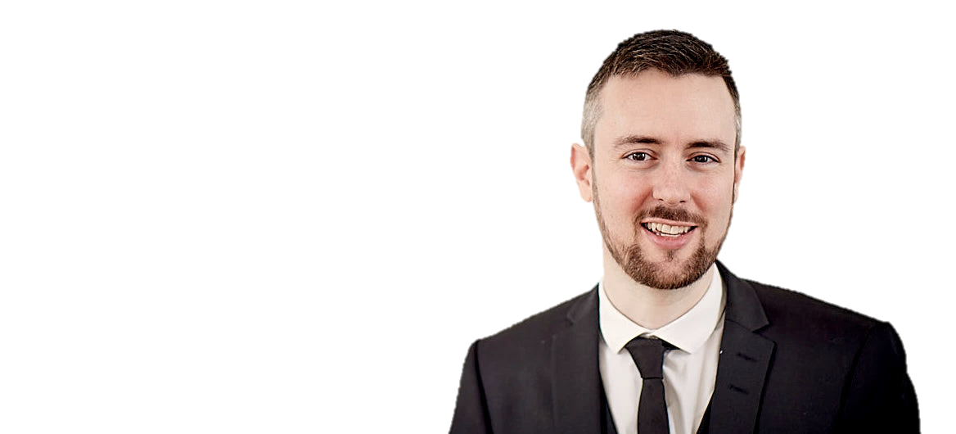
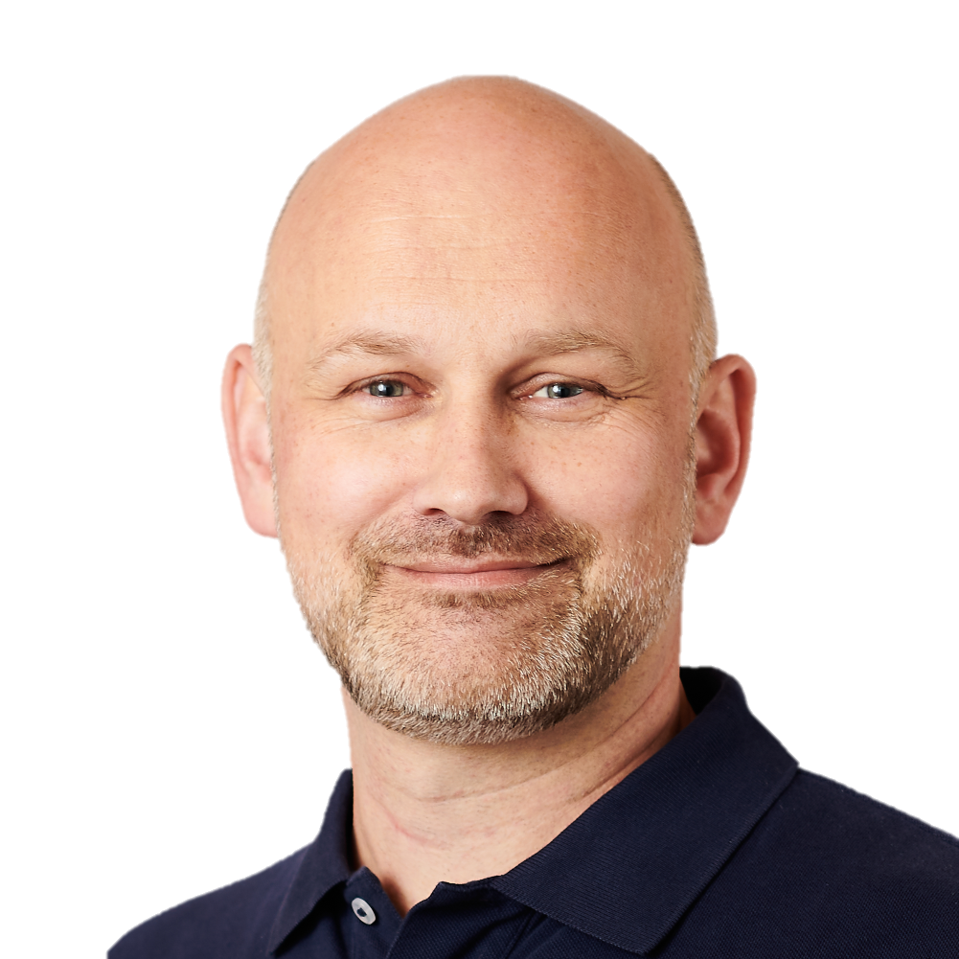
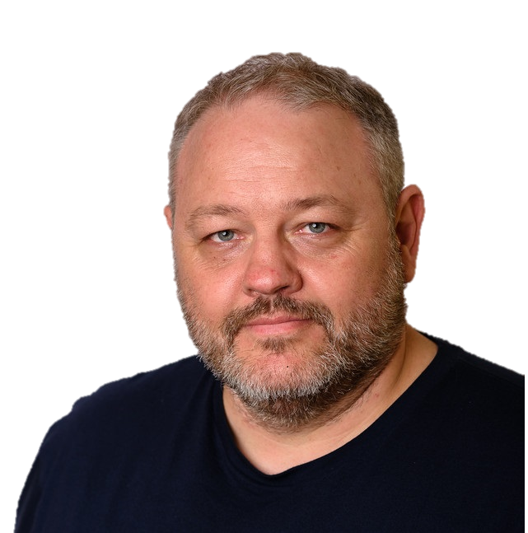
The Team…
Peter Schmidt
Michael Mardahl
Ronni Pedersen

Slide 4

Main focus for Workplace Ninja’s
Microsoft 365 / Modern Workplace
Windows 365 / Azure Virtual Desktop
Microsoft Azure (supporting Microsoft 365)
Security

Slide 5
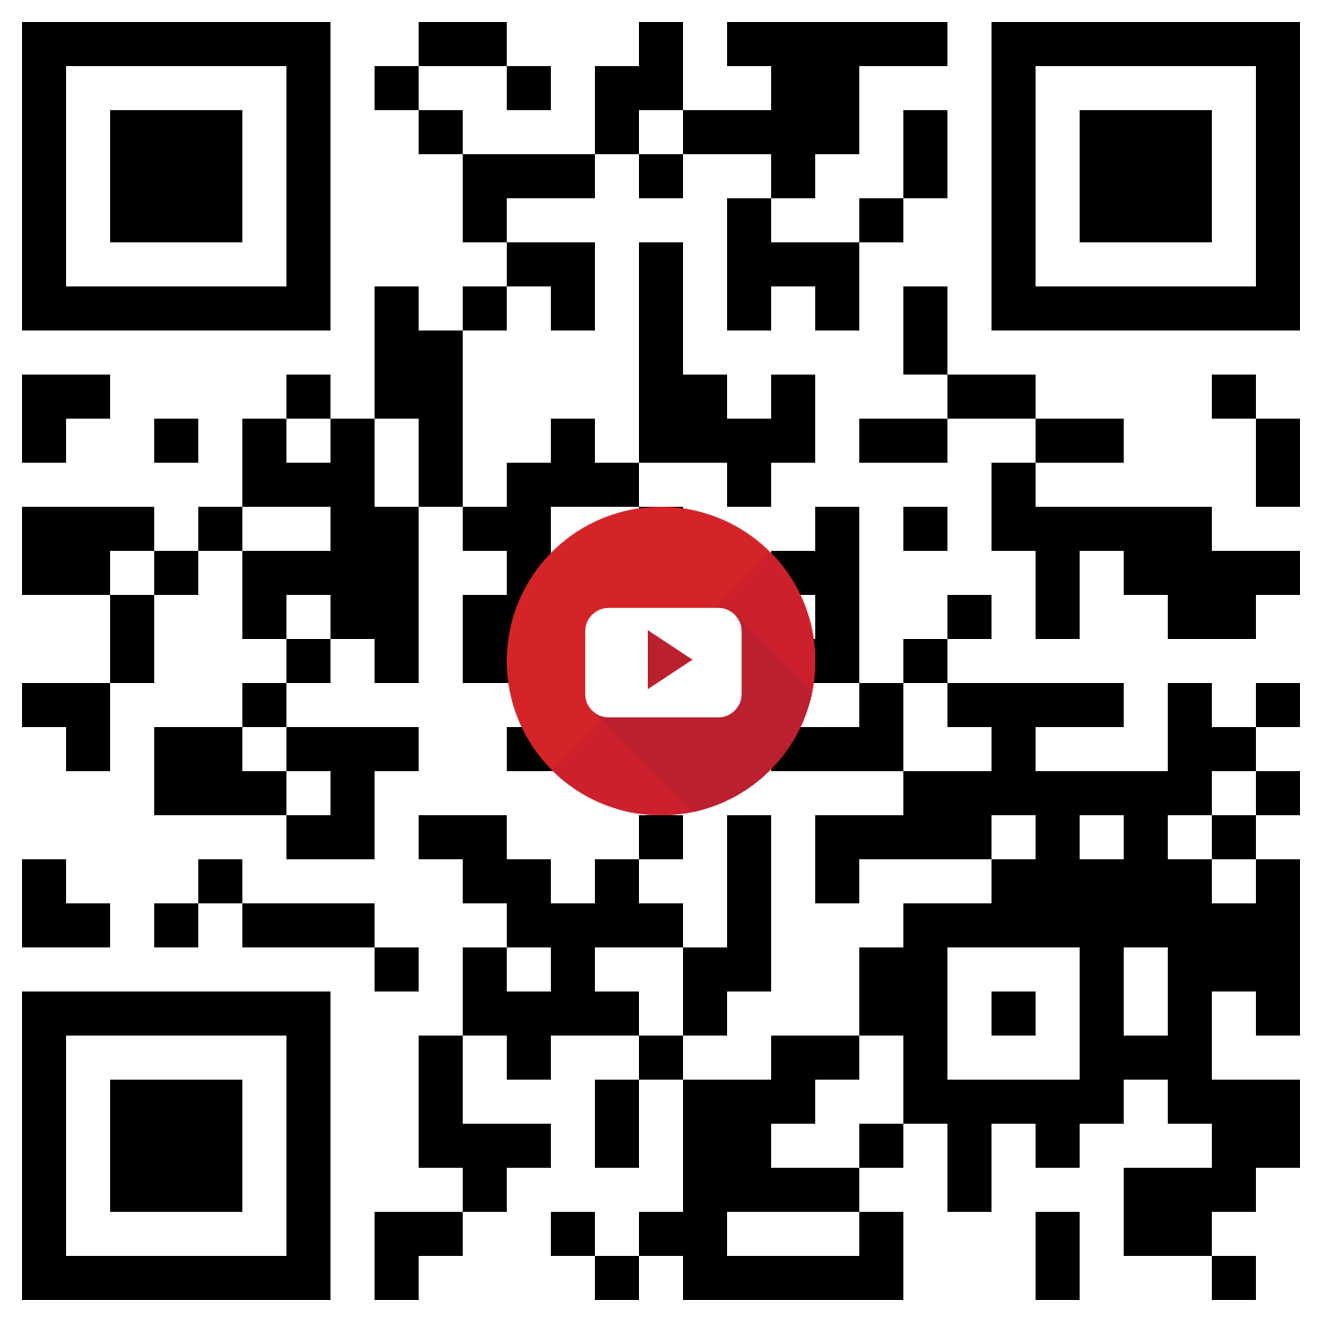

Live Chat on YouTube
YouTube Channel: https://www.youtube.com/c/WorkplaceNinjaUserGroupDenmark/
Chat/Questions: Subscribers only
Min. Subscriber periode: 5 mins.

Slide 6

LinkedIn Group
Workplace Ninja's Danmark
https://www.linkedin.com/groups/14077454/
Announcements
Event Announcements
Speaker Announcements
Recordings

Slide 7
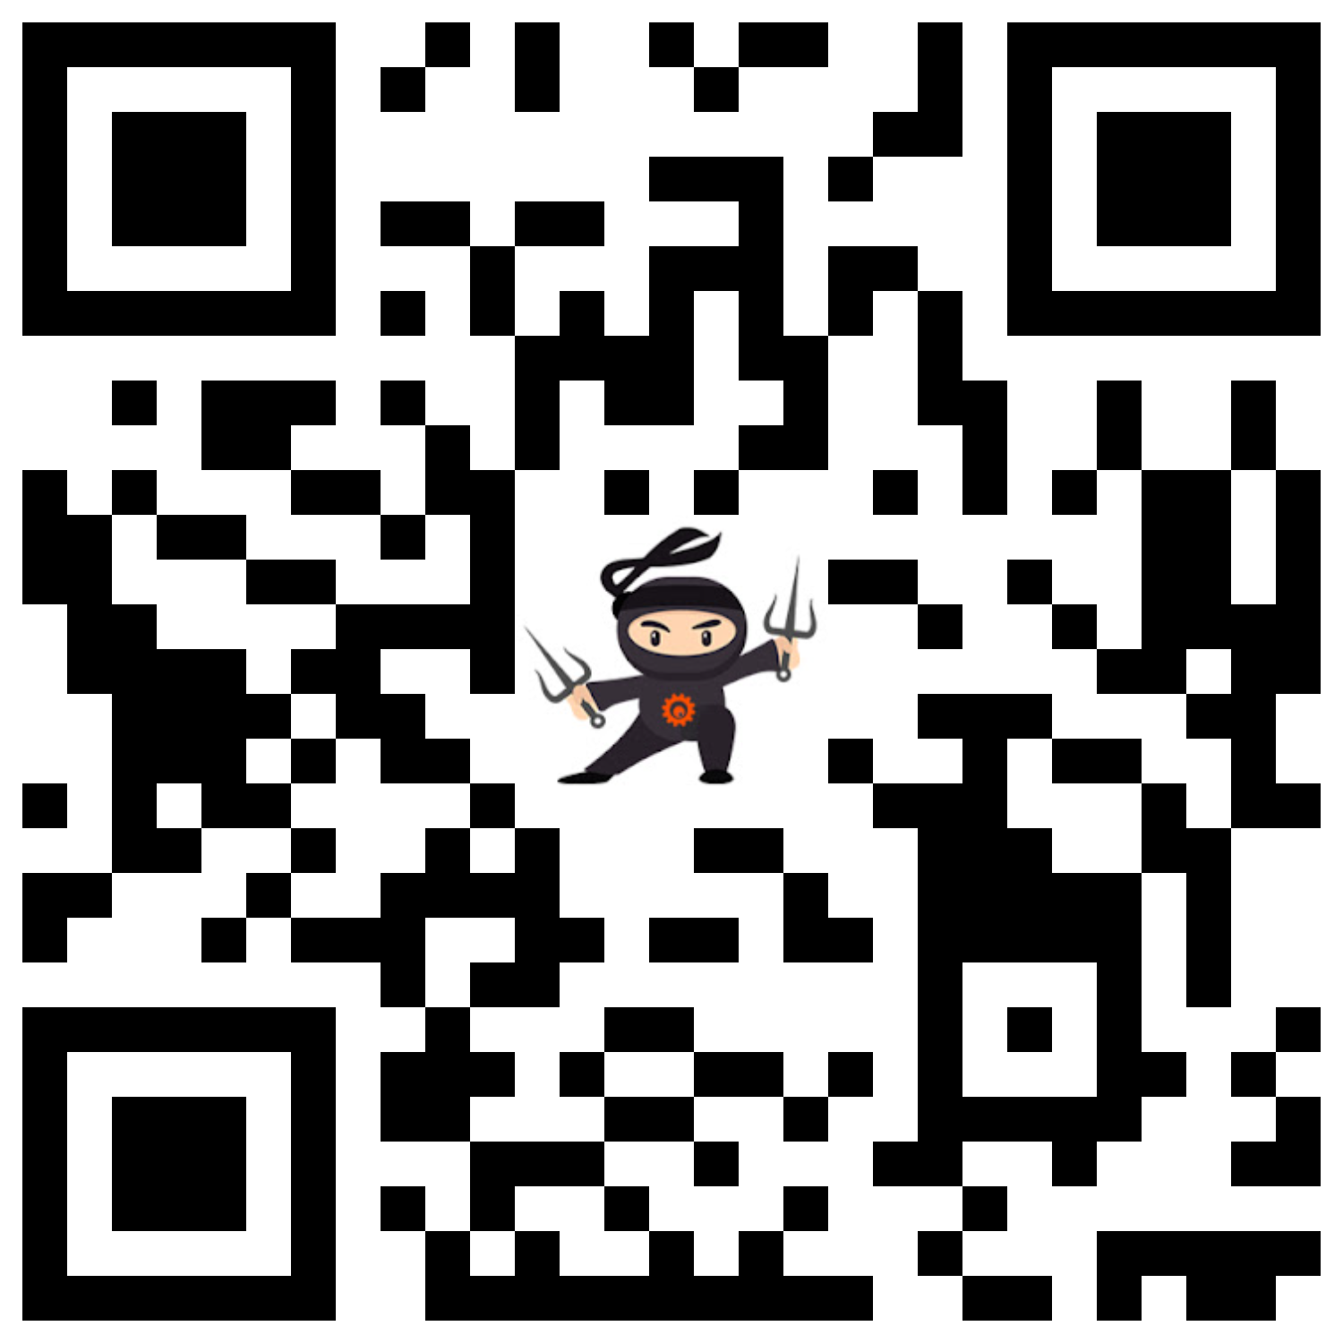
Website
Workplace Ninja's Danmark
https://wpninjas.dk/
General Information
Meetup Calendar
Recordings from previous events
More…

Slide 8
Today’s Agenda
April 2022:
09:00 – 09:05 – Welcome (Ronni & Peter)
09:05 – 10:50 – Policy Management on a Cloudy Day (Per Larsen)
09:50 – 10:35 – Windows 11: What's the status so far (Jesper Nielsen)
10:35 – 11:05 – Get started with CloudLAPS (Nickolaj Andersen)
11:05 – 11:15 – Expert Panel AMA and Wrap-up

Slide 9

Meetup Schedule
Upcoming Events for 2022:
May 6th 2022
June 3rd 2022
July 8th 2022
August 12th 2022
September 9th 2022
October 14th 2022
November 11th 2022
December 9th 2022

Slide 10
Lets get started…

